Slide 1

IB Integrated Design Project
Group Name: “Not quite M1”
Max Karous
Sebastian Burgess
Niall Keating
Sinéad Foley
Alicia Torres Gómez
Léa Gansser Potts
Diego García Medina

Slide 2
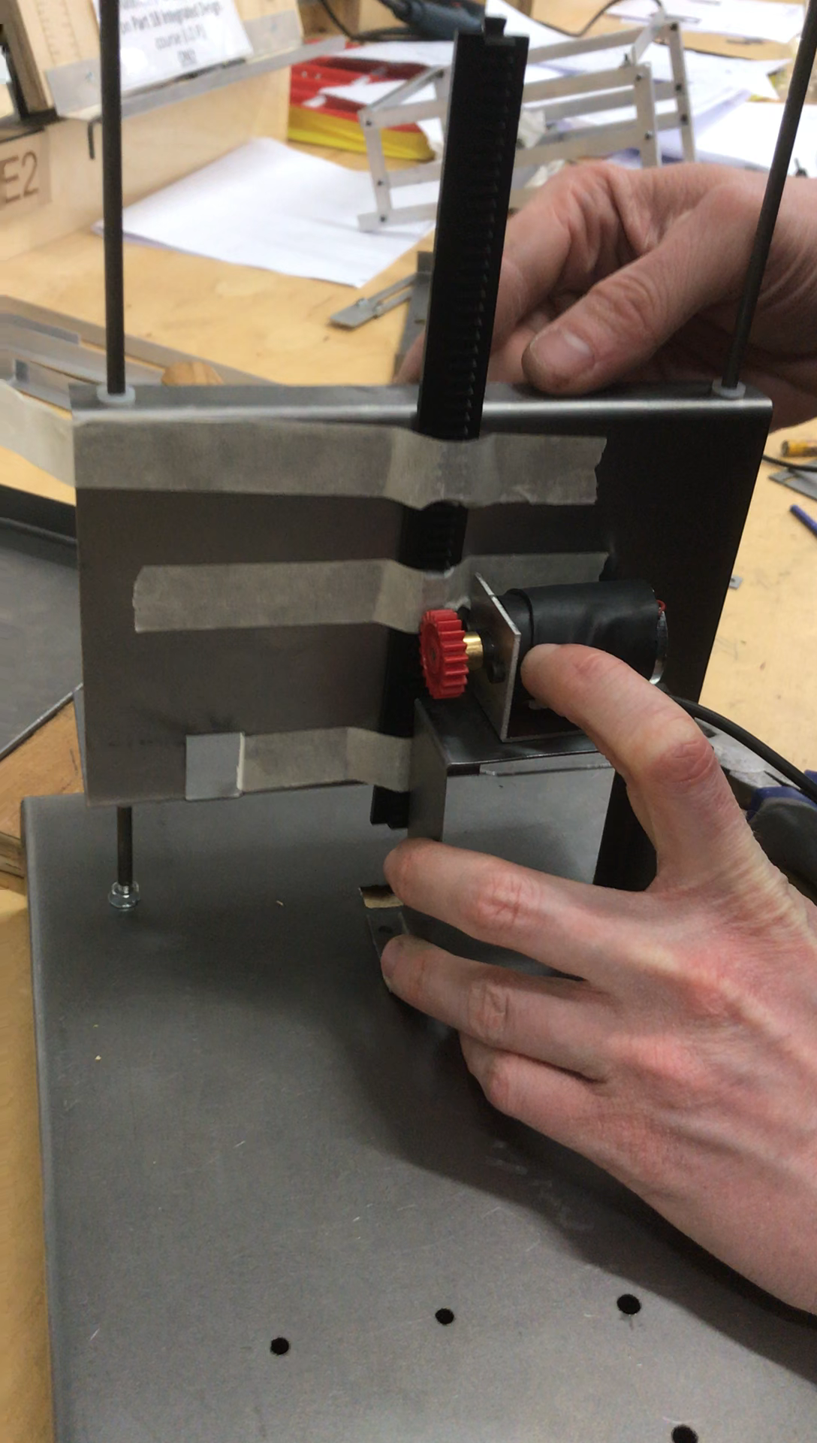
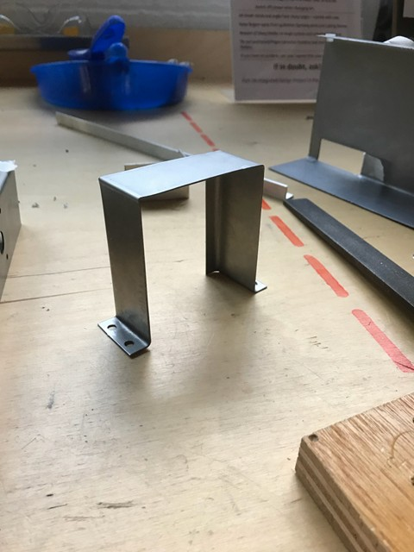
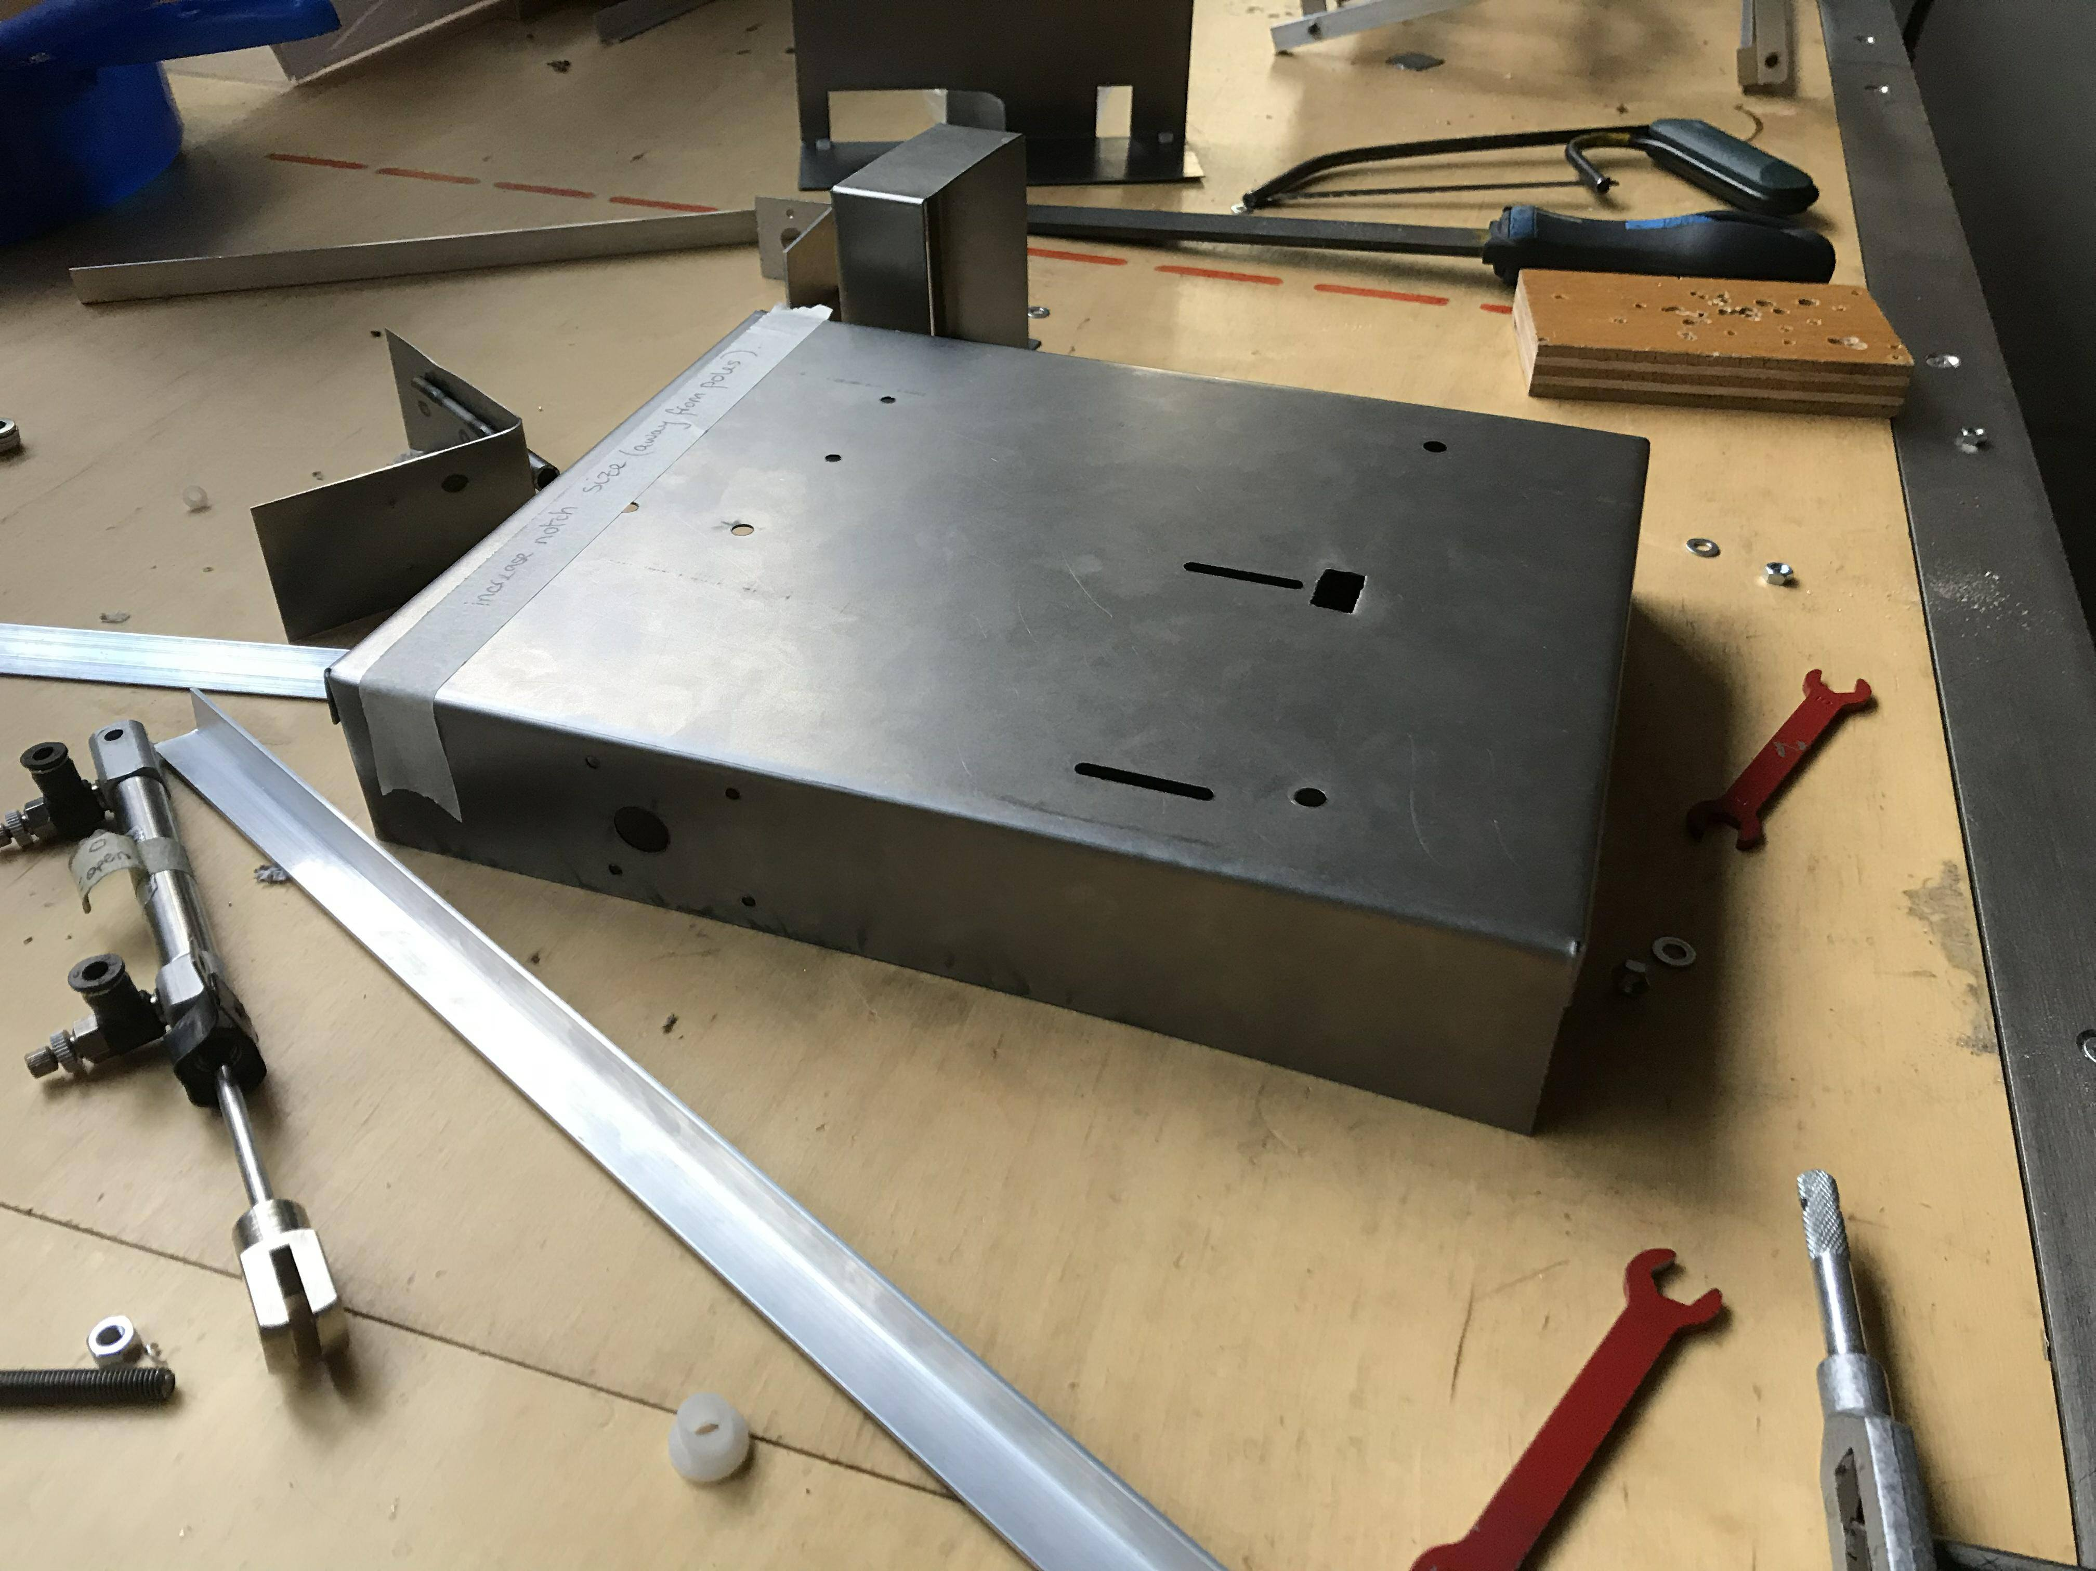
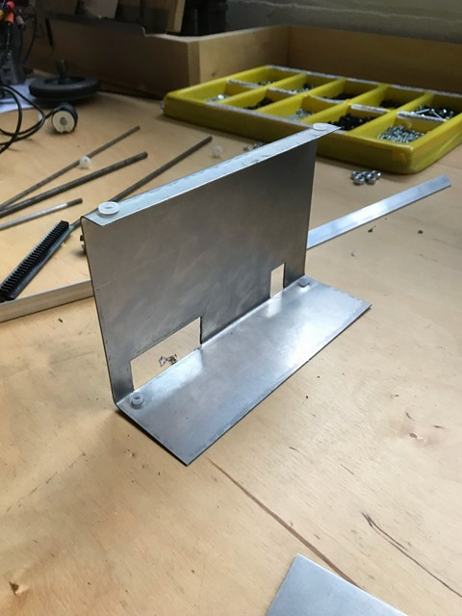
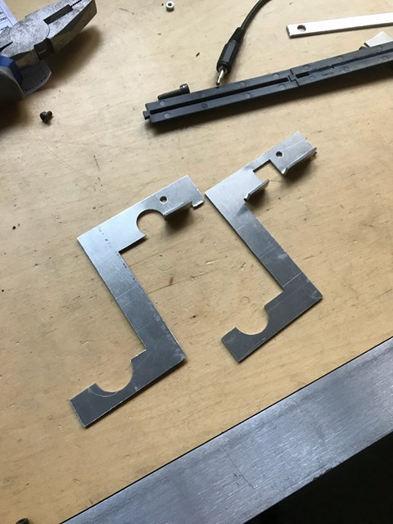
Overall design
Mechanical Sub-team
Max & Sebastian
Initial tests show lift mechanism to have very low friction (see video)
Motors and components fit with good tolerance in chassis
Some modification required to rack fitting

Slide 3
Mechanical Sub-team
Max & Sebastian
Design Modifications Summary
Original | Modification | Reason
Valve assy and PCB in middle | Valve assy and PCB on sides | Prevent sagging in chassis
Bracing on inside of motor raise unit | Bracing along the length of the robot | Better support against buckling
Grabber arms made of steel | Grabber arms made of alum. | Thicker, for better hold on box, and no conductivity
Grabber arms height = 30mm | Grabber arms height = 90mm | Account for wheel height
 | Added flats to grabber arms | Improve slide along plate
Lift mechanism back plate height = 200mm | Back plate height = 110mm | Material savings
30 spoke gear | 20 spoke gear | Improved torque

Slide 4
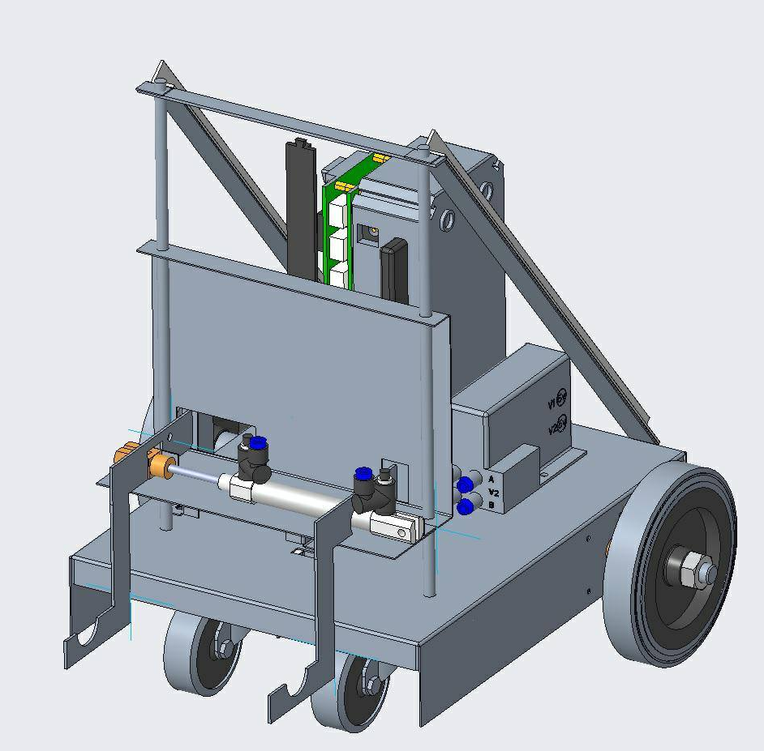
Mechanical Sub-team
Max & Sebastian
To do:
Scrap metal construction of grabber arm mounts and bracing
Complete assembly:
Welding steel tabs (chassis and motor raise unit)
Pop riveting Al – Steel interfaces
Calibrate and testing in conjunction with electrical and software
Simplicity of the design and promising lift mechanism performance lend confidence to the performance of the robot in the final competition

Slide 5
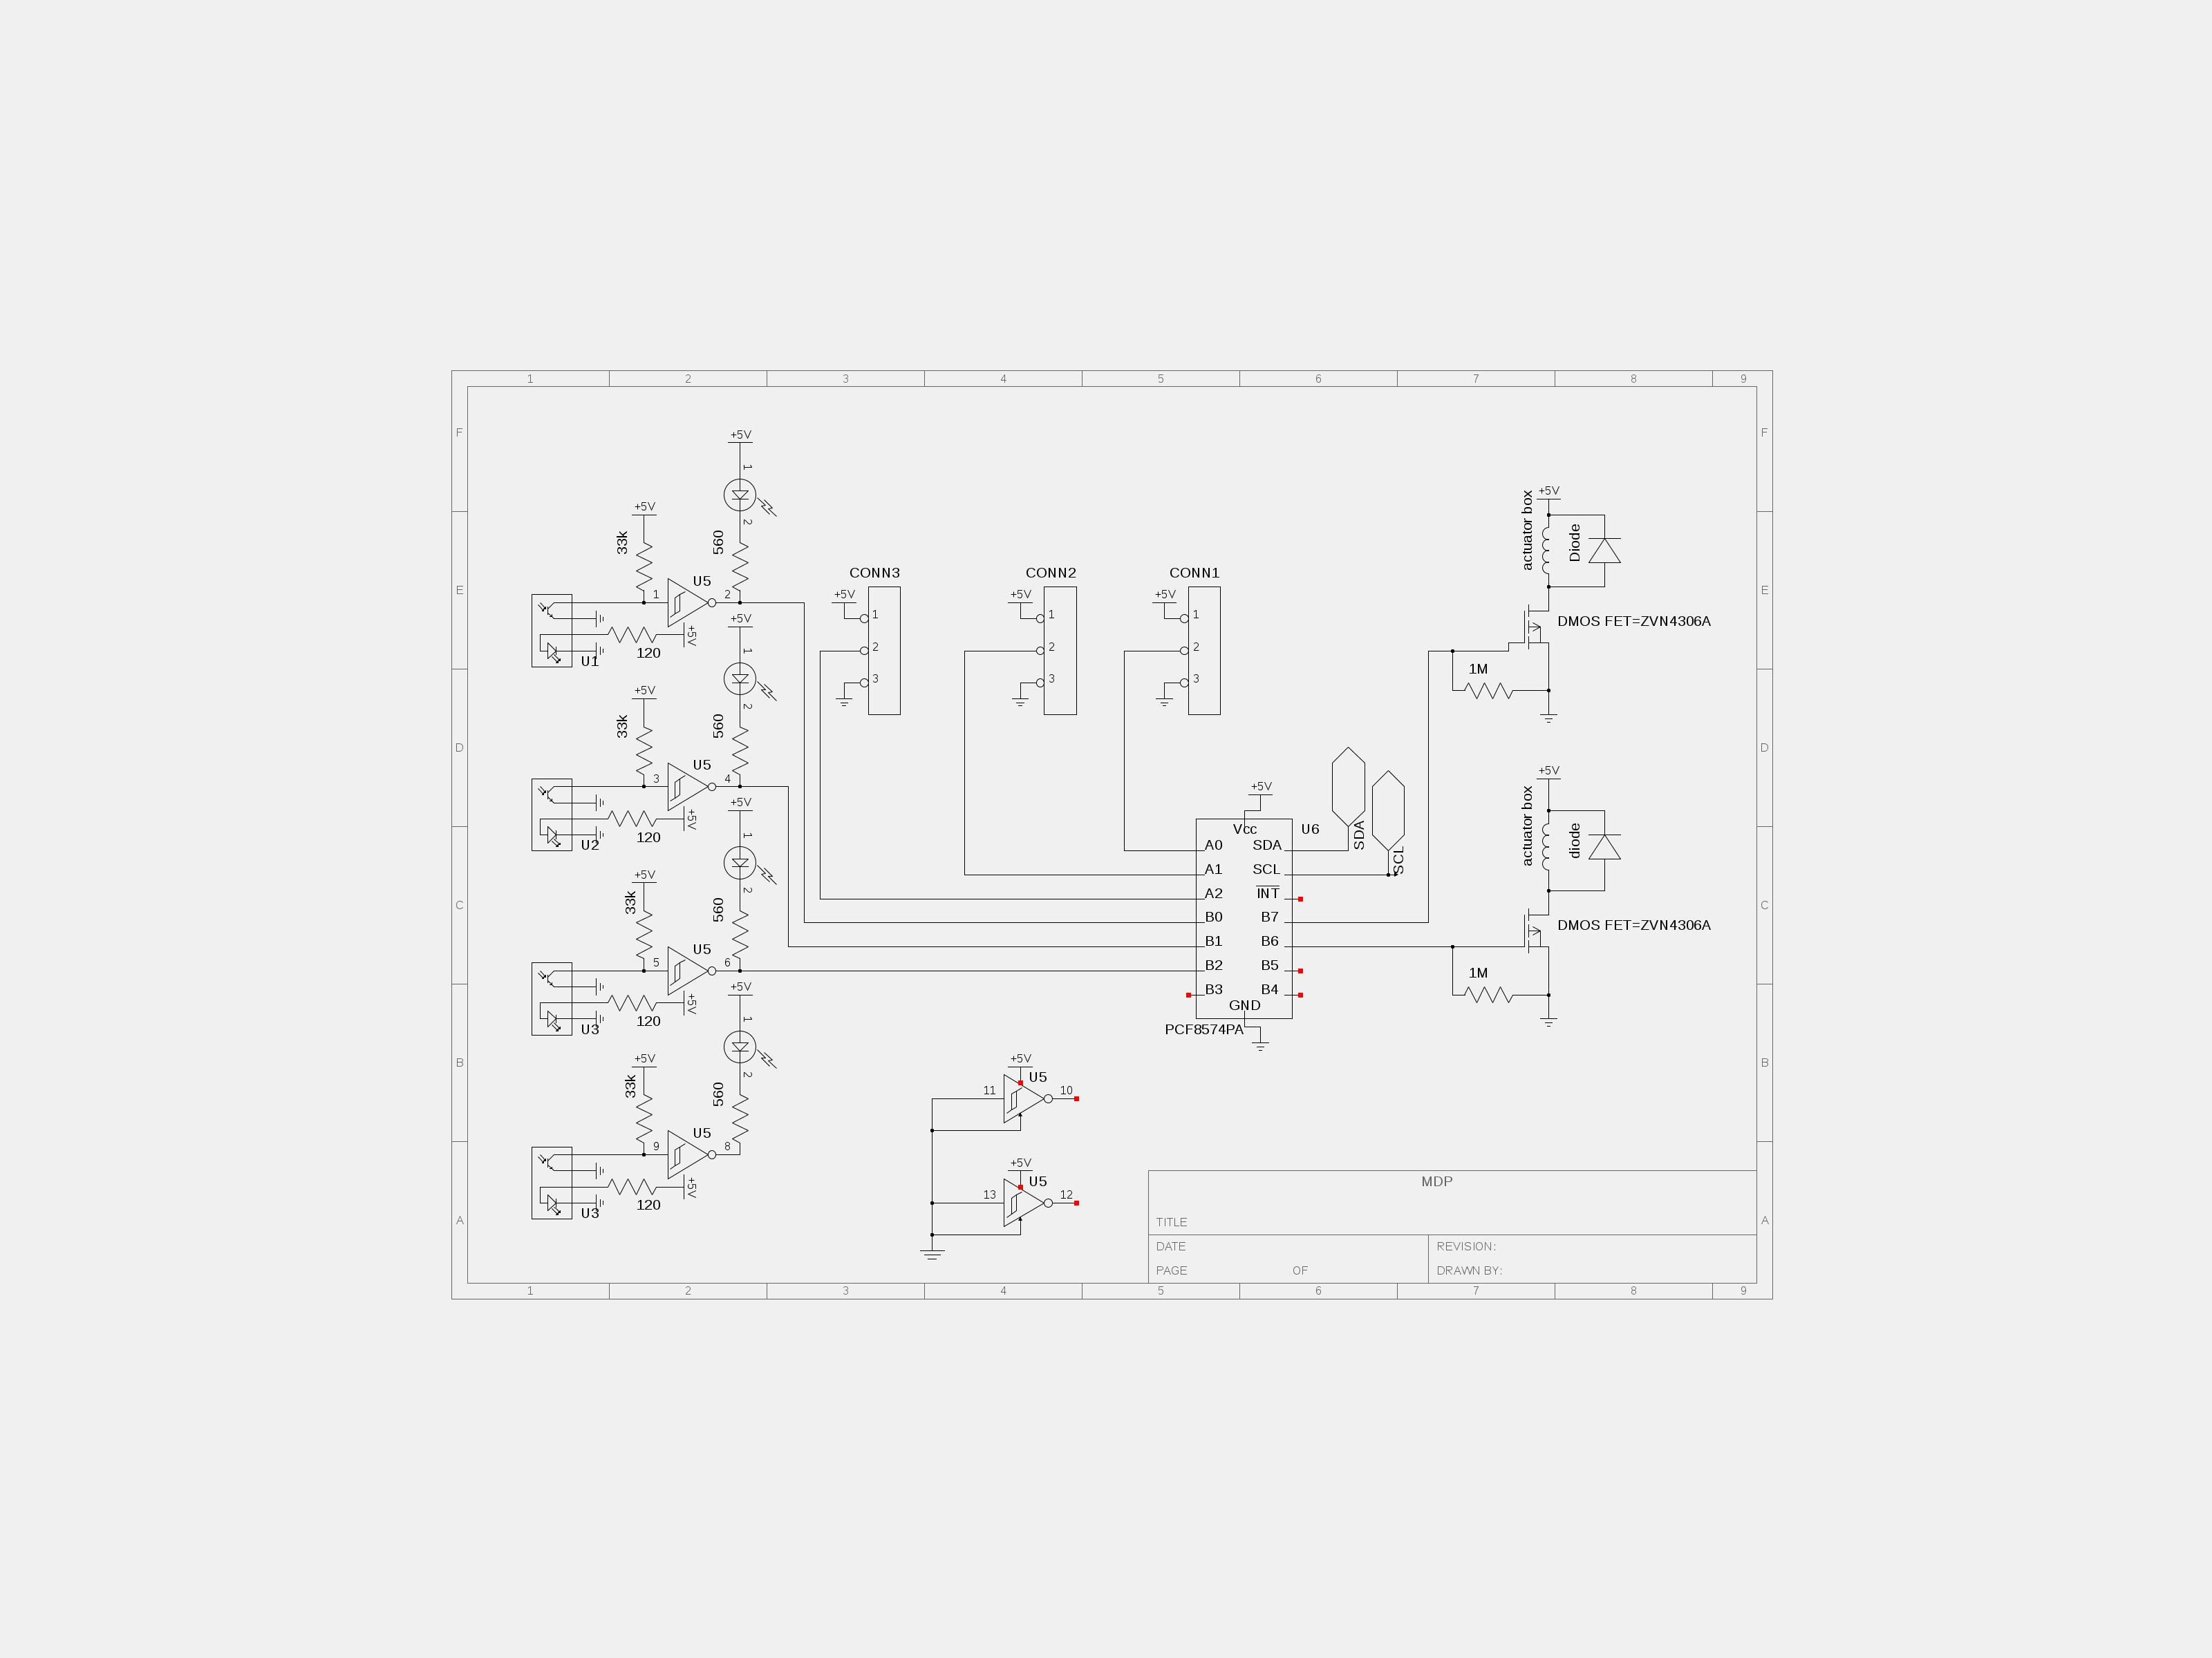
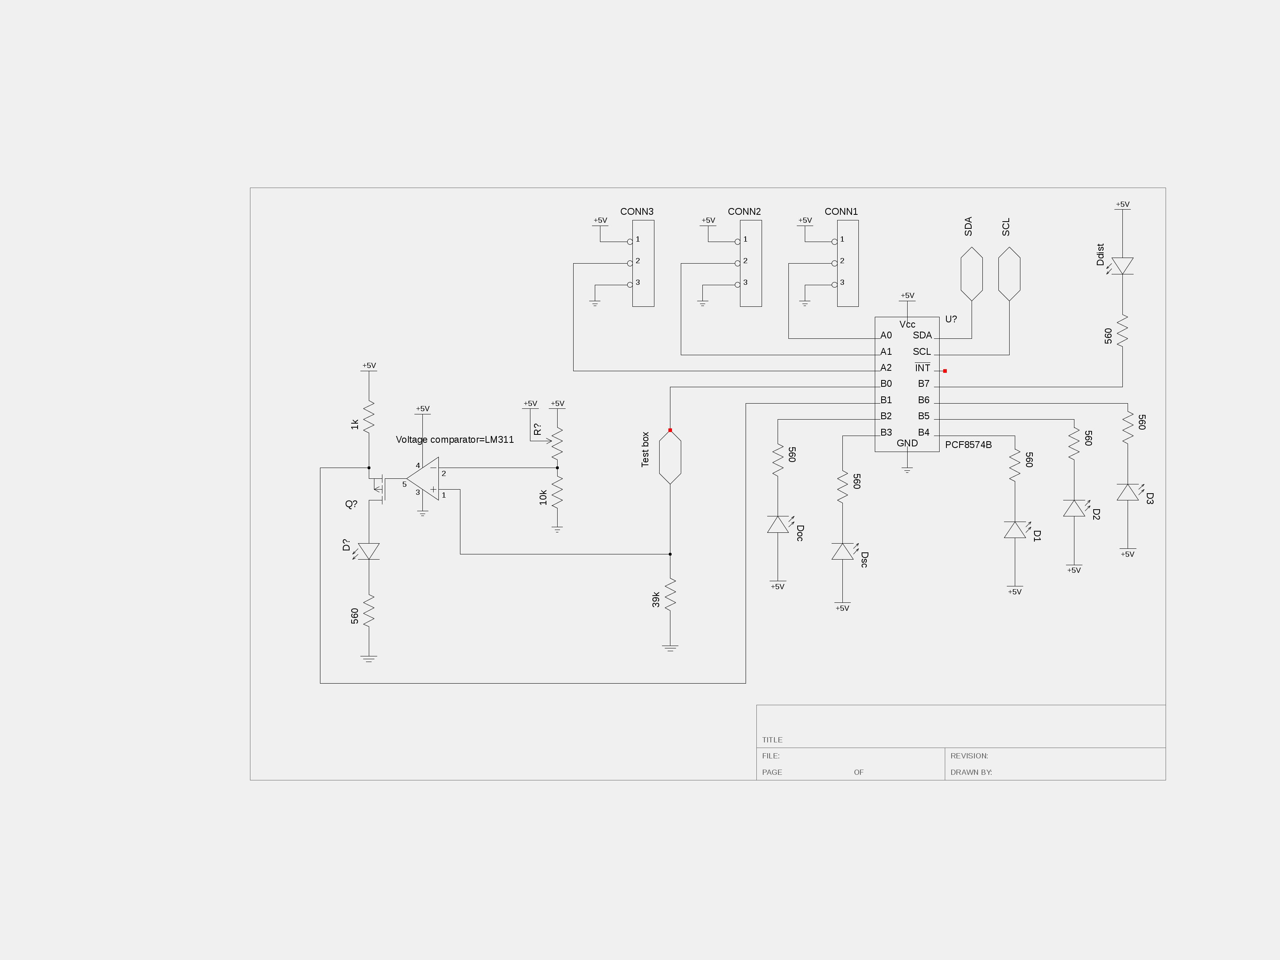
Electrical Sub-team
Sinéad & Niall
Initial designs and issues
Two PCBs laid out as shown
Line following on first board with actuators
Box tester on second board with indicator LEDs
Indicator LEDs had to be on visible board
PCB1 in use so could not be added to during testing
Box testing circuit development delayed
Issues with box tester due to insufficient power supply from PCF8574A
Issues with comparator part of box tester due to voltage at which box signal decayed
Issues with actuator drive circuits due to component placement

Slide 6
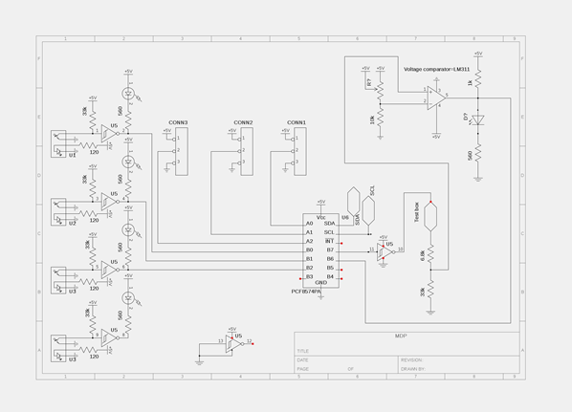
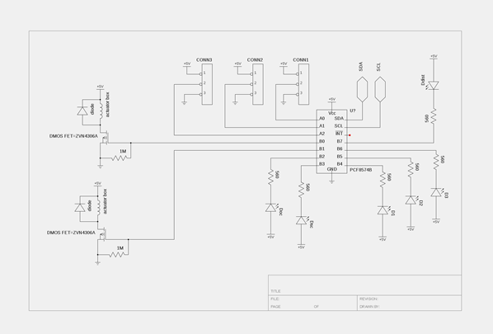
Electrical Sub-team
Sinéad & Niall
Final designs
Both line following and box testing on PCB1
Box testing signal routed through Hex inverter to supply necessary power
Only one Hex inverter required as both circuits on same board
New potential divider added to change decay voltage for easier voltage comparison
LED indicators and actuator drive circuits on PCB2
LEDs easily visible on upper board
Actuator drive circuit components rearranged and corrected

Slide 7
Software Sub-team
Alicia, Léa & Diego
Overall Software Design
Compatibility
Modularity
Maintainability
Capable to operate under different connections with robot
Divided into independent components (i.e. functions and headers)
Functional modifications can easily be accomplished
Reusability
Performance
Fault-tolerance
Could be used with any other robot
It performs the task in the time required without requiring too much memory
Resistant to and able to recover from robot failure

Slide 8
Software Sub-team
Alicia, Léa & Diego
Problems encountered
Change of the sensors readings after implementation of additional circuits on the board by the Electrical Team
Lack of alignment between line-following sensors and powered wheels
Reliability of the distance sensor
Trying to write the code so that it is as easy as possible to calibrate when we test it with our actual robot
In rare cases, failure to detect a junction when it should
Line following sensors
Wheel
axle

Slide 9
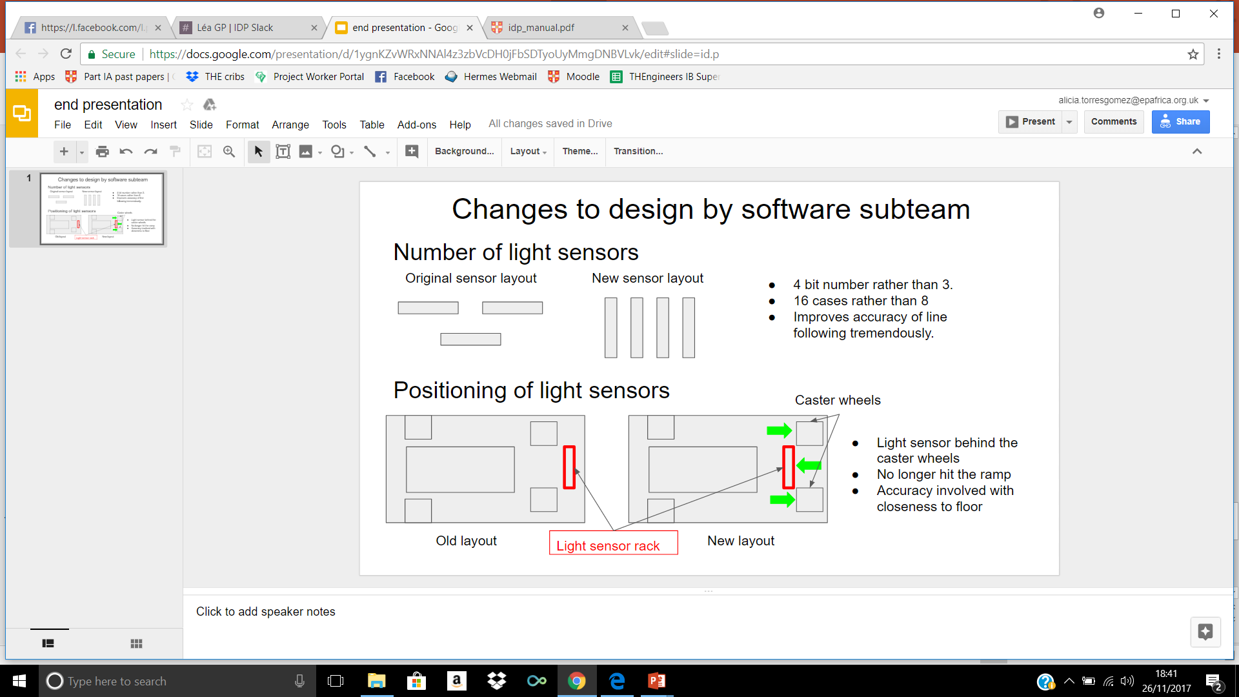
Software Sub-team
Alicia, Léa & Diego
Changes to the design
Number of light sensors
4 bit number rather than 3
16 cases rather than 8
Improves accuracy of line following tremendously
Light sensor behind the caster wheels
No longer hits the ramp
Accuracy involved with closeness to floor
Original Sensor Layout
New sensor layout
Positioning of sensors

Slide 10
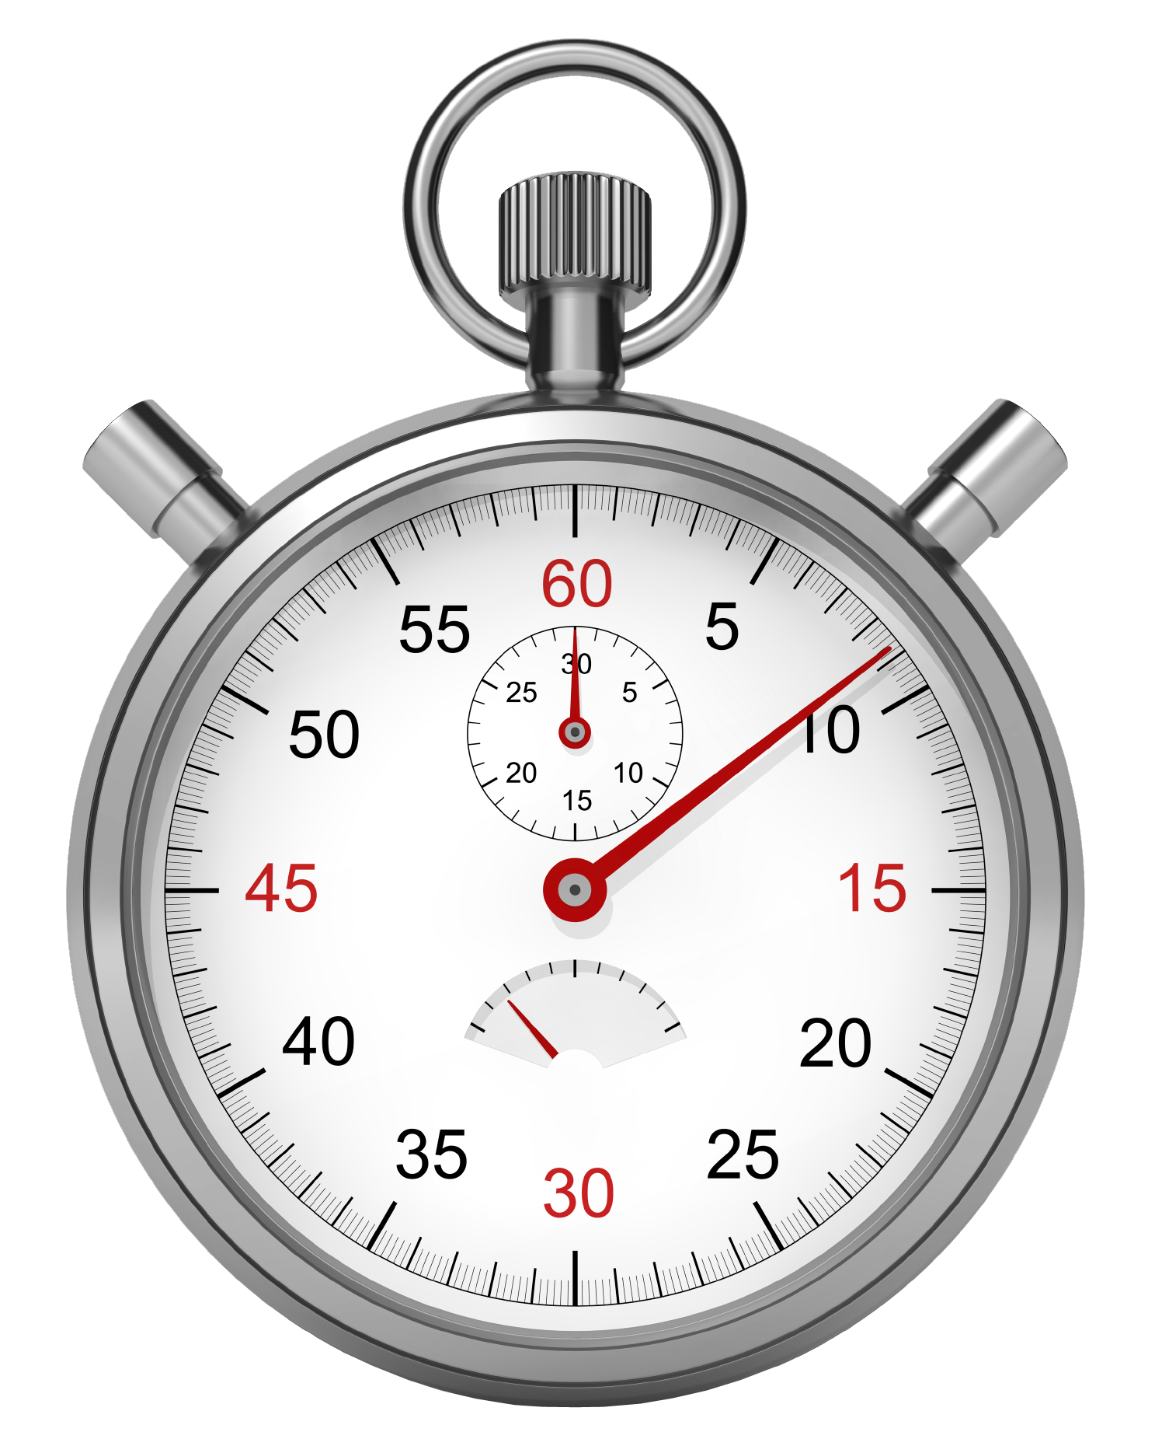
Likely Performance
2-3 boxes delivered, instead of 5, but in the correct position (real speed under estimated 0.45 m/s.)
Measurement of distance between robot and box is inconsistent, which might lead to difficulties in collection.
Wall detection is relatively reliable, but there is a small probability of the robot hitting the wall before stopping.
Line following will be smooth, but turns will be constrained by space.
Box testing is sensitive to shaking when taking measurements (grabber vibrations will play an important role).

